Slide 1
Front End Engineering-I Project
NAME OF THE STUDENT | ROLL NUMBER
RAMANPREET SAINI | 2410990616
SUKHBIR SINGH | 2410990636
SAMARJEET SINGH | 2410990755
UDAYVEER SINGH | 2410990640
Faculty Coordinator- Dr Chetna Sharma
Chitkara University Institute of Engineering and Technology,
Chitkara University, Punjab

Slide 2
Table of Contents
Introduction
Problem Statement
Technical Details
Key Features
Project Highlights
Bonus Feature(optional)
Conclusion
References/Links used

Slide 3
.
Introduction
Project Title: Music Player
Objective: To create a user-friendly web-based music player using HTML, CSS, JAVASCRIPT.
Our project is a Music Player built using HTML, CSS, Javascript. It allows users to play and pause an audio file, as well as seek through the track using a progress bar. The player is small in size and styled with basic, responsive CSS for easy integration through websites. Javascript allows to adjust audio and switching b/w tracks. It Provides control over multimedia elements.
Features:
Play, pause, and stop audio functionality.
Interactive progress bar for tracking and seeking the audio position.
Technologies Used:
HTML for structure, CSS for styling and layout, Javascript for making web pages interactive.
Outcome: A functional, lightweight music player that provides basic playback controls and enhances user experience on the web .

Slide 4
Problem Statement
We came up with this project because it seems that established music players had some drawbacks which could be rectified for better user experience :
Complex User Interfaces:
Most modern music players come with overwhelming interfaces, which can be difficult for users seeking a minimalist and easy-to-navigate experience.
Resource-Intensive Players:
Many players consume a significant amount of system resources, impacting the performance on low-end devices.
Charging premium :
Companies like Spotify charges a subscription to unlock some premium features
and to play songs at better quality
Customization for Personal Projects:
There is a need for a customizable music player that can be integrated into personal projects or websites with ease, fulfilling basic requirements without unnecessary complexity.
Advertisements for revenues:
Offcourse companies run advertisements to make profits and get back their
development cost which could be very annoying for an user

Slide 5
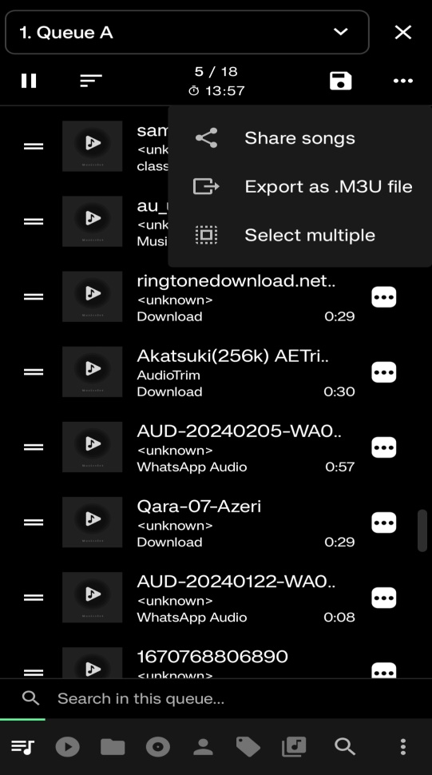
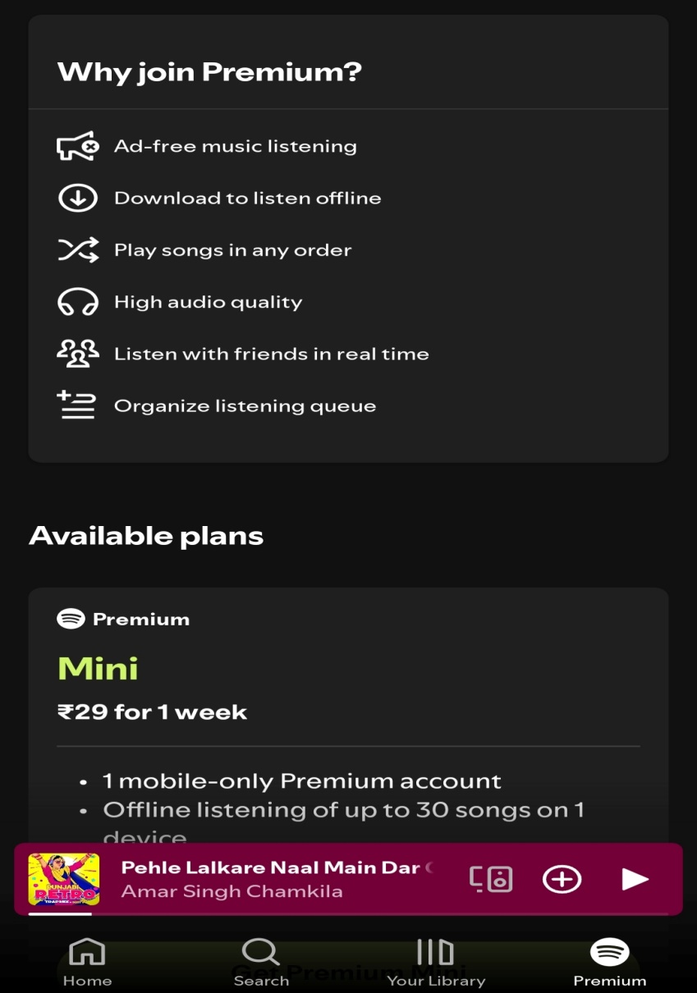
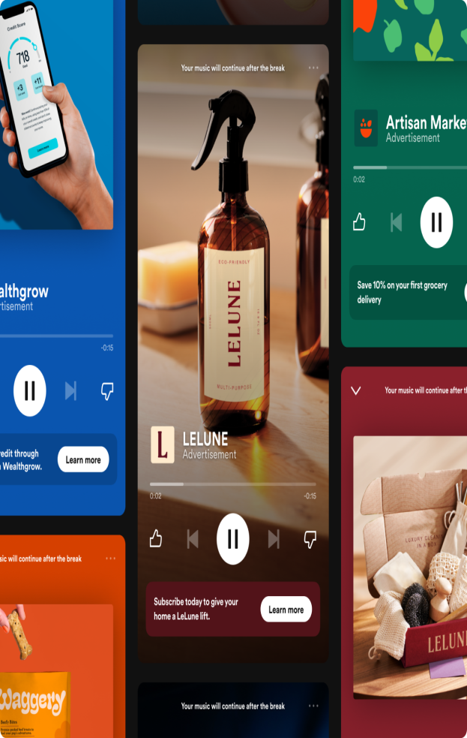
Problems to be addressed
AD In between songs to
Ruin user experience
Example of a complex
User interface
Pay premium price to unlock better
features

Slide 6
Technical Details
HTML Structure:
1-Uses the <audio> element to embed an audio file.
2-Includes dummy buttons for play, pause, and stop controls using <button> tags.
3-A <input type="range"> element serves as the progress bar.
CSS Styling:
1-Styles buttons and the player container with CSS for a clean and minimalistic look.
2-Ensures responsiveness, making the player adaptable to various screen sizes.
3-Dummy play/pause/stop button for clean and better looks.
JAVASCRIPT:
1-Used to make the music player respond to user interactions and track audio progress.
2-document.getElementById used to select an HTML element by its unique id attribute.
3-Makes dummy play/pause/stop button working.

Slide 7
We have added the following features to make our music player more appealing and interactive
Play/Pause/Stop Controls
Essential buttons like Play , Pause , Stop which provides the basic interaction needed for a music player.
Responsive and Simple User Interface
A clean and intuitive layout with CSS ,according to users personal choice he can make changes in CSS code according to his preference moreover UI is responsive.
Audio Format Compatibility
We have ensured that player should support common audio formats like MP3 to ensure the widest usability for various audio files.
Browser Compatibility
Moreover the music player works across different browsers, ensuring accessibility to a broad audience.
Key Features

Slide 8
Key Features
• Theme Toggle
Switches between light and dark modes using a themeToggle button.
• Sidebar Menu
• Contains options for navigating songs and toggling between “All Songs” and “Favorites”.
• Visibility toggled dynamically (toggleSidebar()).
• Favorites Management
• Users can mark/unmark songs as favorites.
• Favorites are displayed in a separate view.
• Add New Songs
Option to add custom songs with title, artist, file path, and cover image.
• Genres Menu (Placeholder for Future Expansion)
Prepares for categorising songs based on genres.

Slide 9

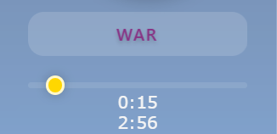
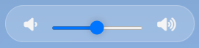
REPRESENTATION OF KEY FEATURES
These are the Functional buttons
We have used for better design
This is Fully Functional Progress Bar of Songs
These are the functional buttons
For volume adjustment

Slide 10
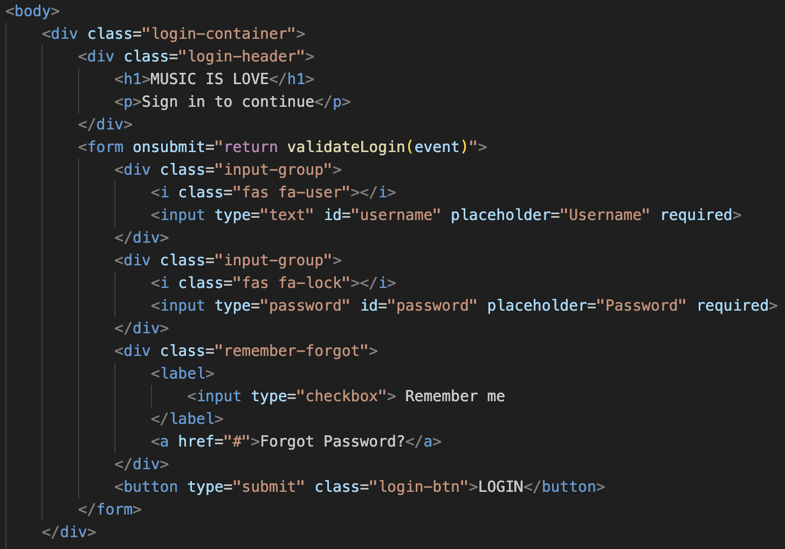
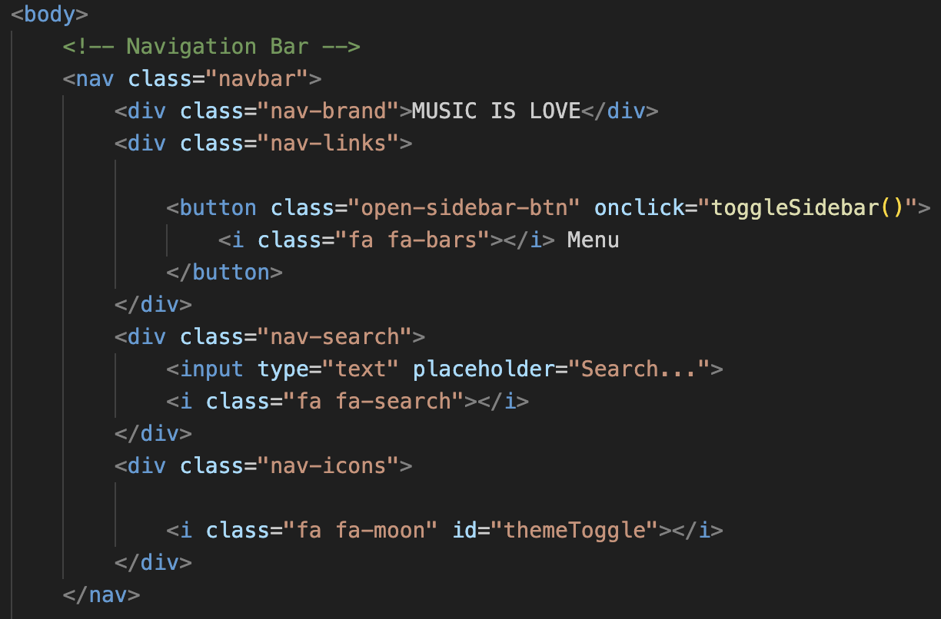
Project Highlights
HTML CODE USED IN THE PROJECT

Slide 11
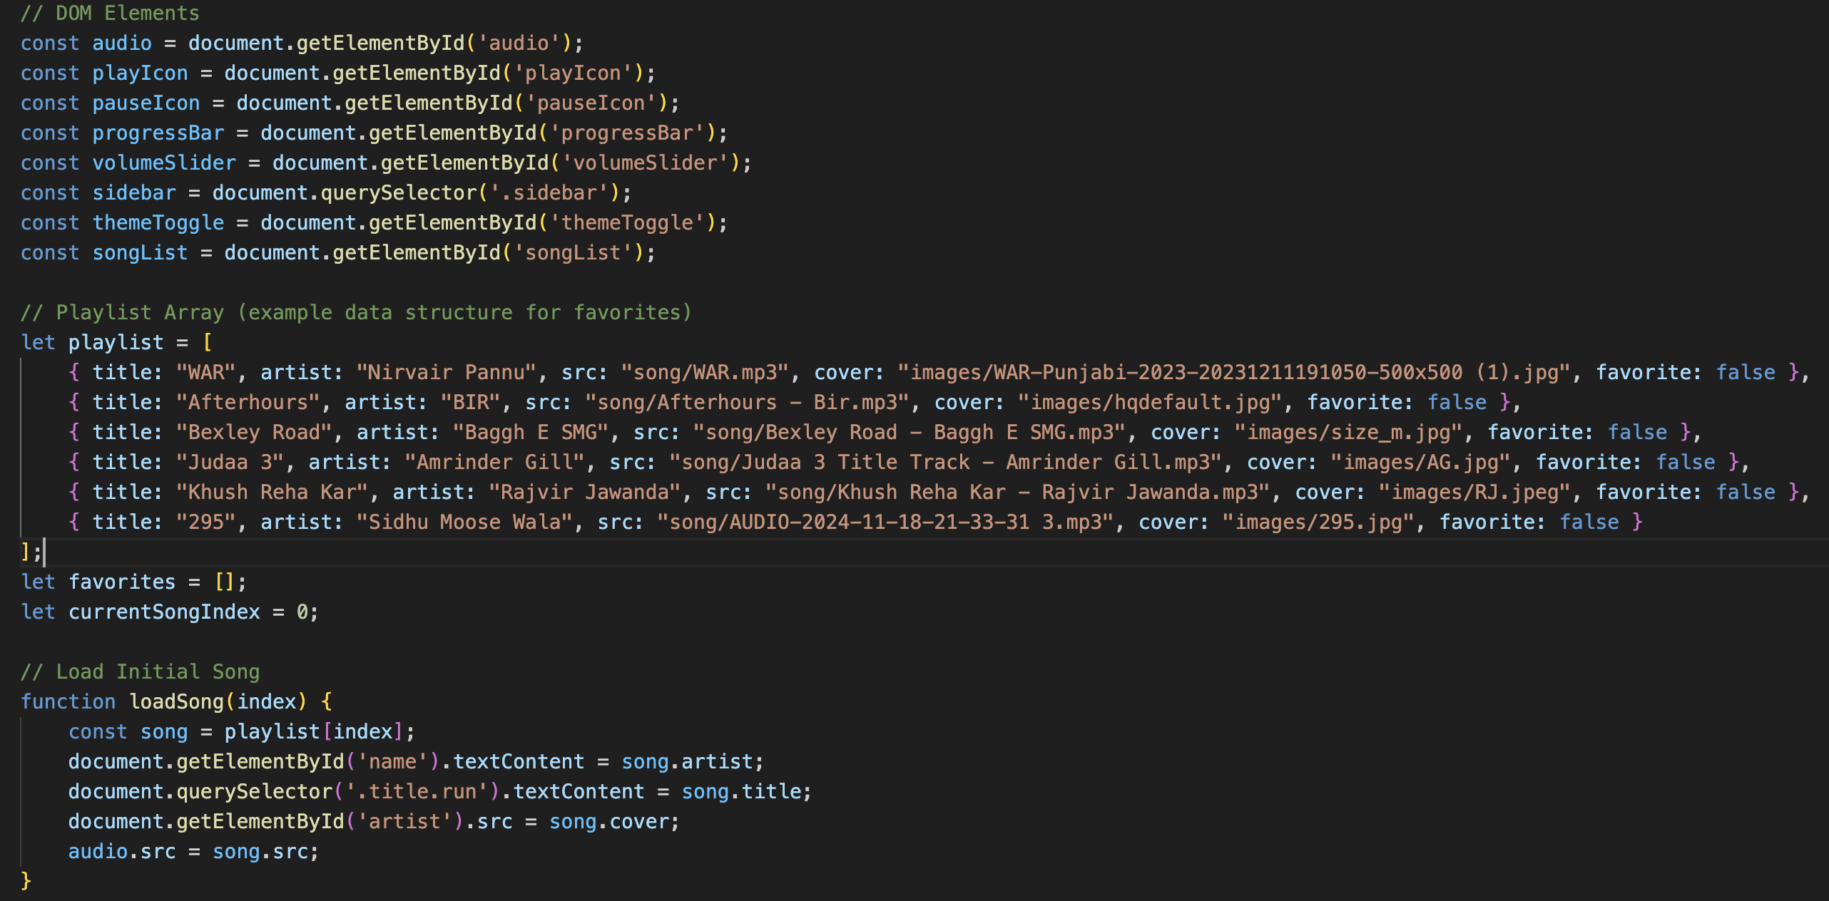
Project Highlights
Script used in the project

Slide 12
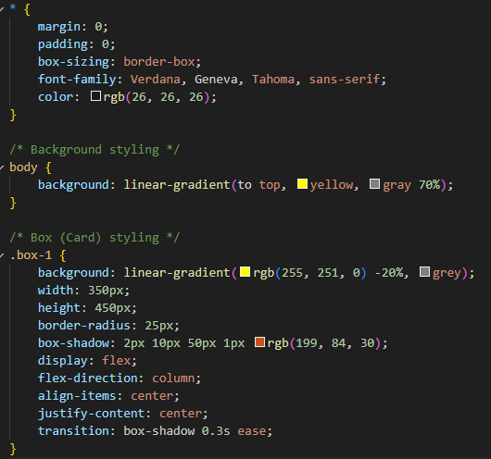
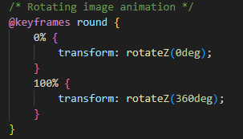
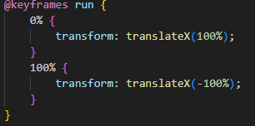
Project Highlights
CSS USED FOR THE BODY OF THE MUSIC PLAYER

Slide 13
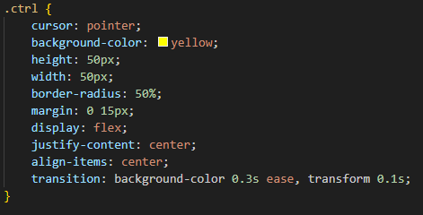
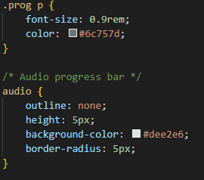
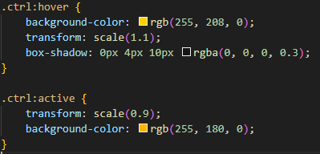
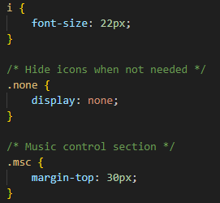
Project Highlights
CSS USED FOR THE MUSIC PLAYER AND BUTTONS

Slide 14
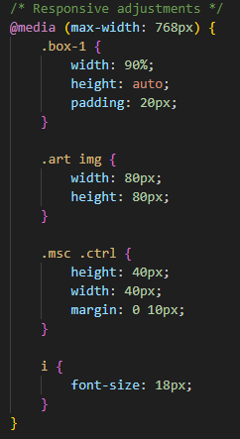
Project Highlights
This is the @media tag we have used to make
Our music player functional on various devices
With different screen size , This is how
Our project is responsive for different
Devices.

Slide 15
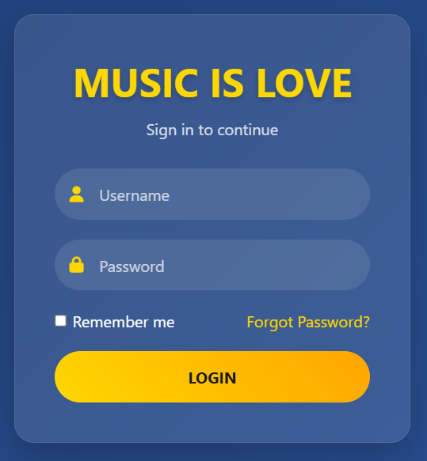

Login Page
Enter Your Username Here
Enter Your Password Here

Slide 16
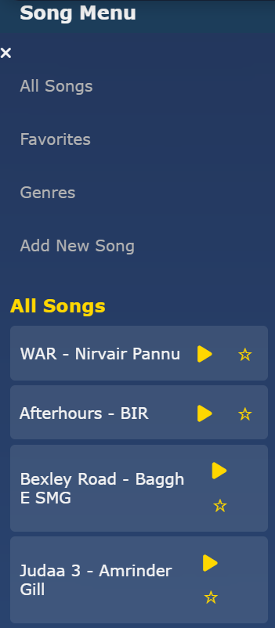
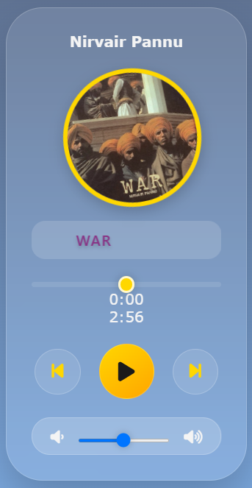
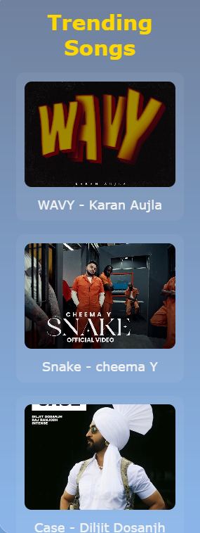
Features of Music Player
Menu Bar
Player
Trending Section

Slide 17
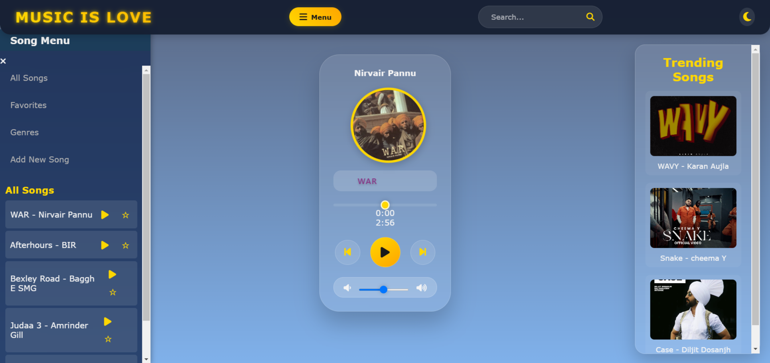
Final project look

Slide 18
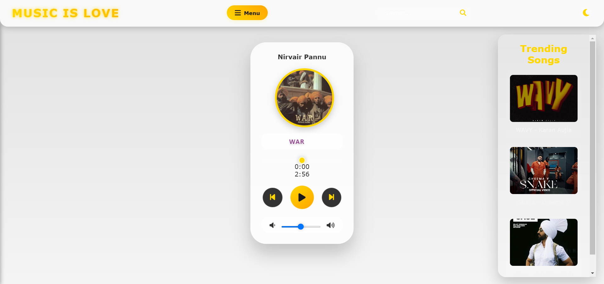
Light Mode of Music Player

Slide 19
Conclusion
The development of the simple music player was a valuable learning experience for the team, allowing us to explore the integration of core web technologies such as HTML, CSS, JAVASCRIPT.
Key Points:
Basic Features: The music player successfully includes play, pause, stop, and progress tracking functionality, making it easy for users to interact with audio files.
Responsive Design: CSS ensured that the player is adaptable to various screen sizes and devices.
Flexibility: The music player supports various audio formats like mp3, WAV etc.
Team’s Main Takeaways:
1-Understanding the fundamentals of audio control using JavaScript.
2-Gaining experience in designing responsive web elements using CSS.
3-The importance of user interface simplicity for better user experience.
4-Realising the potential for future enhancements and expansion of this basic project.

Slide 20
References/Links used
MDN Web Docs – HTML <audio> Element
https://developer.mozilla.org/en-US/docs/Web/HTML/Element/audio
W3Schools – HTML Audio/Video DOM Reference https://www.w3schools.com/tags/ref_av_dom.asp
CSS-Tricks – Styling Input Range
https://css-tricks.com

Slide 21


